Slide 1




HUGGING FACE
Presented by: Sourour Hammoud
August 23,2025

Slide 2
Hugging Face
Types of Writing Tools
Dummy Agent Library
Smolagents
Plan
LlamaIndex
LangGraph
2

Slide 3
Hugging Face
3

Slide 4
Introduction
Hugging Face is a platform and library for leveraging machine learning models for a wide range of tasks, including conversational AI, natural language processing, computer vision, and sentiment analysis and classification. By offering pre-trained models and an open-source library, Hugging Face makes it easier for you to integrate AI technologies into your applications [1].
4

Slide 5
Components
Transformers library
Model Hub
Data sets
5

Slide 6
Types of Writing Tools
6

Slide 7
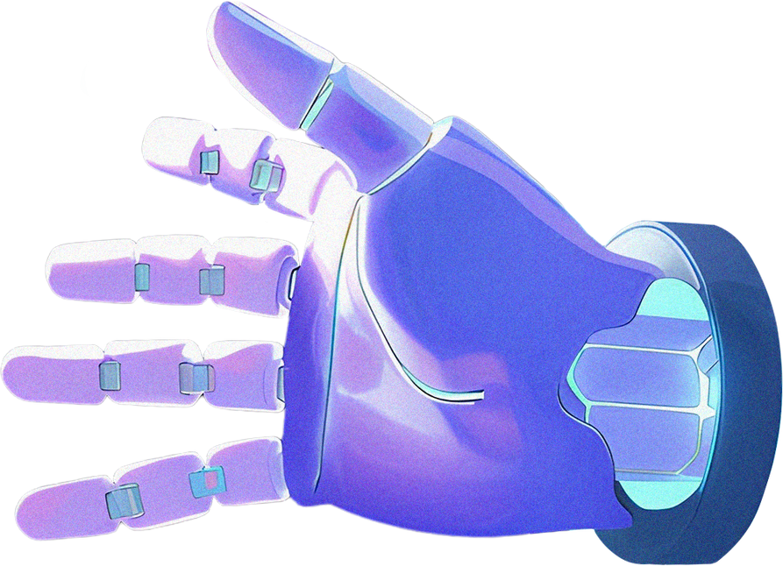
Define a tool in an LLM model by providing a clear textual description, specifying its inputs and outputs, and linking it to a callable function [2].
Example of format:
Tool Name: calculator,
Description: Multiply two integers.,
Arguments: a: int, b: int,
Outputs: int
7

Slide 8
Two Types of Writings Tools
Auto Formatting Tool Sections
Generic Tools Implementation
from typing import Callable
class Tool
def __init__(self, name: str, description: str, func: Callable, arguments: list, outputs: str):
self.name = name
self.description = description
self.func = func
self.arguments = arguments
self.outputs = outputs
@tool
def calculator(a: int, b: int) -> int:
return a * b
print(calculator.to string())
8

Slide 9
Dummy Agent Library
9

Slide 10
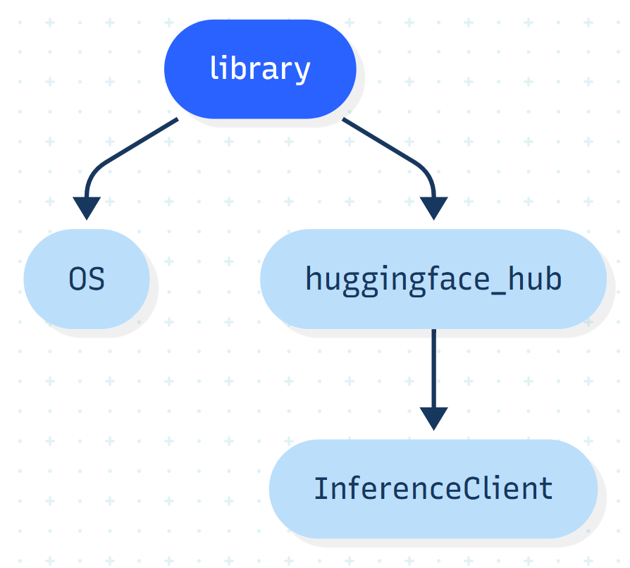
10

Slide 11
client.chat.completions.create(
messages=messages, stream=False, max_tokens=200,
)
messages =
[ {"role": "system", "content": SYSTEM_PROMPT},
{"role": "user", "content": ""},
{"role": “assistant", "content": ""}]
System Prompt (Prompt engineering) is the process of writing effective instructions for a model, such that it consistently generates content that meets your requirements [4].
output.choices[0].message.content
11

Slide 12
Smolagents
12

Slide 13
What is Smolagents?
Smolagents is a library that provides a framework for developing your agents.
This lightweight library is designed for simplicity, but it abstracts away much of the complexity of building an Agent, allowing you to focus on designing your agent’s behavior.[2].
13

Slide 14
Advantage of Smolagent
Flexible LLM Support
Simplicity
Code-First Approach
HF Hub Integration
14

Slide 15

Transformer Model: Implements a local transformer pipeline for seamless integration [2].
InferenceClient Model: Calls a severless inference API, Usually via hugging face or via a growing number of third party inference providers [2].
Type of Model in Smolagent
LitelLMModel: a lightweight framework for running models efficiently [2].
OpenAIServerModel: Connects to any service that offers an OpenAI API interface [2].
15

Slide 16

Type of Agent
Code Agent
Tool Calling Agents
Code agents are the default agent type in smolagents. They generate Python tool calls to perform actions, achieving action representations that are efficient, expressive, and accurate [2].
these agents use the built-in tool-calling capabilities of LLM providers to generate tool calls as JSON structures. This is the standard approach used by OpenAI, Anthropic, and many other providers [2].
16

Slide 17
Writing actions in code rather than JSON offers several key advantages:
Composability
Object Management
Generality
Natural for LLMs
17

Slide 18
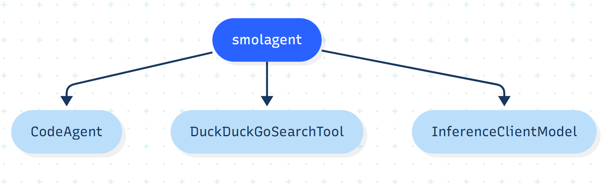
Example of how I can create AI Agents using CodeAgent
18

Slide 19
Example of how I can create AI Agents using CodeAgent
agent = CodeAgent (tools=[DuckDuckGoSearchTool()], model=InferenceClientModel())
agent.run("Search for the best music recommendations for a
party at the Wayne's mansion.")
19

Slide 20
Default Toolbox
UserInputTool
DuckDuckGoSearchTool
PythonInterpreterTool
finalAnswerTool
GoogleSearchTool
VisitWebpageTool
20

Slide 21
RAG (Retrieval Augmented Generation
Retrieval Augmented Generation (RAG) systems combine the capabilities of data retrieval and generation models to provide context-aware responses [2].
When building agentic RAG systems, the agent can employ sophisticated
strategies like:
Query Reformulation
Query Expansion
Multi-Step Retrieval
Query Decomposition
Source Integration
Result Validation
21

Slide 22
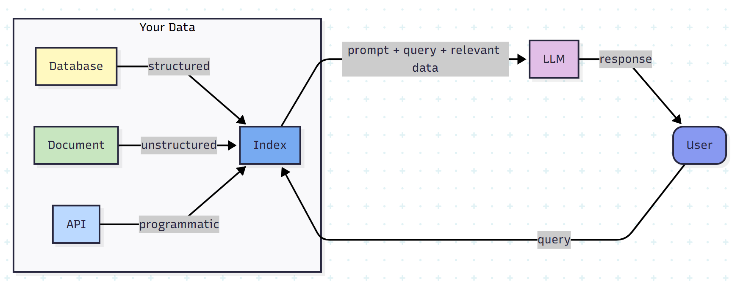
RAG (Retrieval Augmented Generation
22

Slide 23
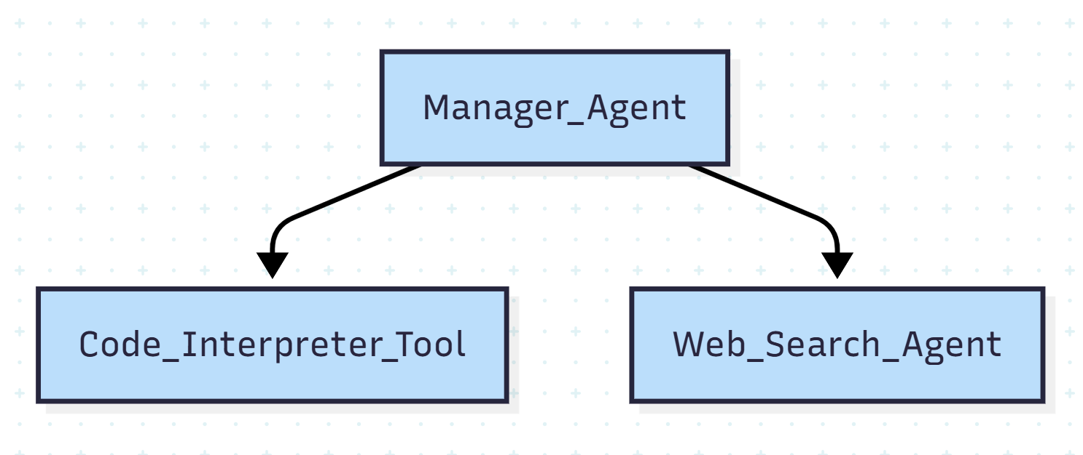
Multi Agent In Somlagents
In smolagents, different agents can be combined to generate Python code, call external tools, perform web searches, and more. By orchestrating these agents, we can create powerful workflows [2].
simple multi-agent architecture
23

Slide 24
Vision Agents with Smolagents
Empowering agents with visual capabilities is crucial for solving tasks that go beyond text processing. Many real-world challenges, such as web browsing or document understanding, require analyzing rich visual content. Fortunately, smolagents provides built-in support for vision-language models (VLMs), enabling agents to process and interpret images effectively. [2].
24

Slide 25
LlamaIndex
25

Slide 26
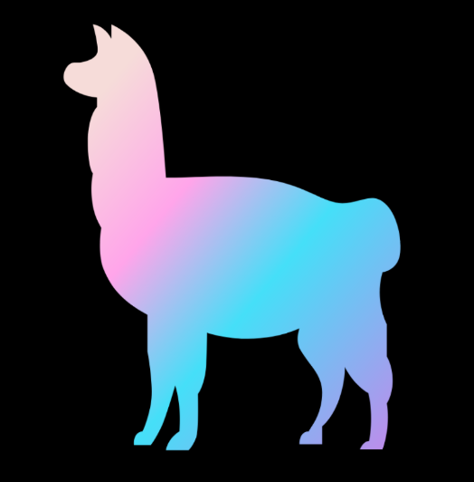
What is LlamaIndex?
LlamaIndex is an open source data orchestration framework for building large language model (LLM) applications. LlamaIndex is available in Python and TypeScript and leverages a combination of tools and capabilities that simplify the process of context augmentation for generative AI (gen AI) use cases through a Retrieval-Augmented (RAG) pipeline [3].
26

Slide 27
What Makes LlamaIndex Special
Clear Workflow System
Advanced Document Parsing with LlamaParse
Many Ready-to-Use Components
LlamaHub
27

Slide 28
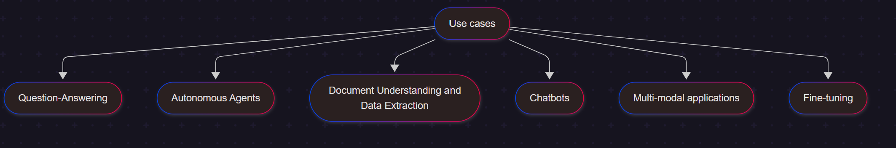
28

Slide 29
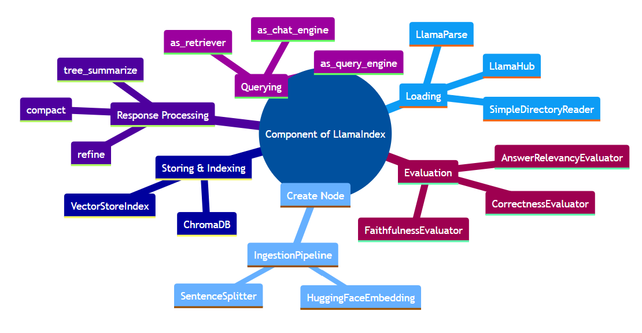
Components in LlamaIndex to build RAG
29

Slide 30
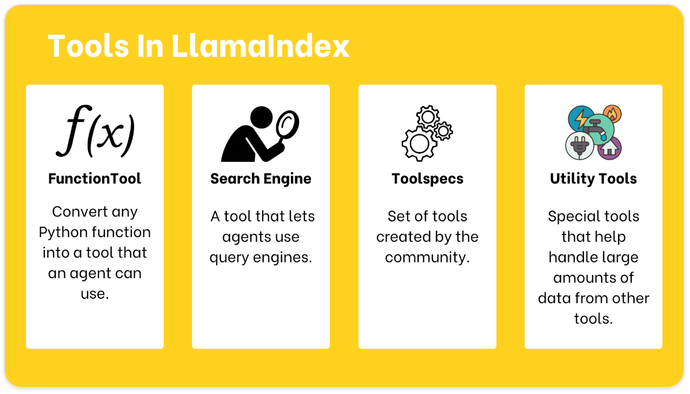
Using Tools in LlamaIndex
[6]
30

Slide 31
Creating a Function Tool
from llama_index.core.tools import FunctionTool
tool = FunctionTool.from_defaults(
get_weather,
name="my_weather_tool",
description="Useful for getting the weather for a given location.",
)
tool.call("New York")
Name Of Function
The name and description
are particularly important
as they help the agent
understand when and how
to use the tool effectively.
31

Slide 32
Creating a QueryEngine Tool
from llama_index.core.tools import QueryEngineTool
tool = QueryEngineTool.from_defaults(
query_engine,
name=“some useful name",
description=“some useful description.",
)
tool.call("New York")
This is query that loading, storing and indexing to get ready to search
32

Slide 33
Creating Toolspecs
from llama_index.tools.google import GmailToolApec
tool_spec = GmailToolSpec()
Tool_spec_list = tool_spec.to_tool_list()
[(tool.metadata.name, tool.metadata.description) for tool in tool_spec_list]
load the toolspec and convert it to a list of tools.
To get a more detailed view of the tools
33

Slide 34
Utility Tools
Oftentimes, directly querying an API can return an excessive amount of data, some of which may be irrelevant, overflow the context window of the LLM, or unnecessarily increase the number of tokens that you are using [6].
Two main utility tools:
OnDemandToolLoader
LoadAndSearchToolSpec:
Loading tool
Search tool
34

Slide 35
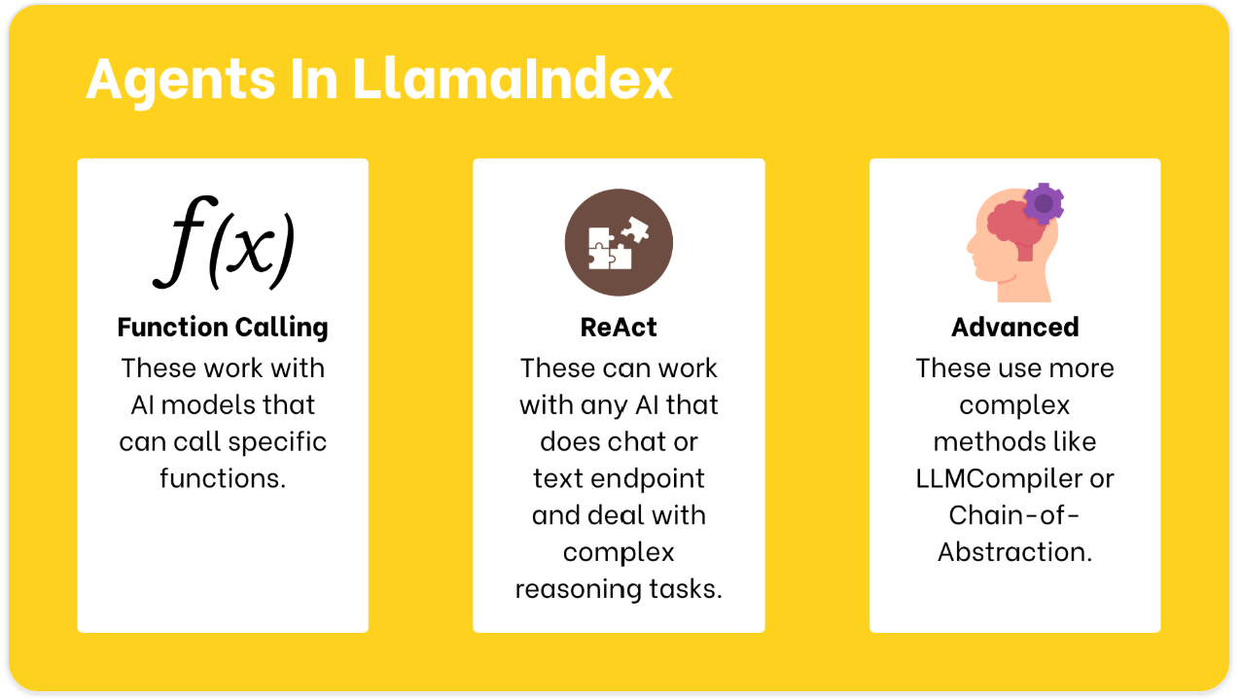
Agent in LlamaIndex
[6]
35

Slide 36
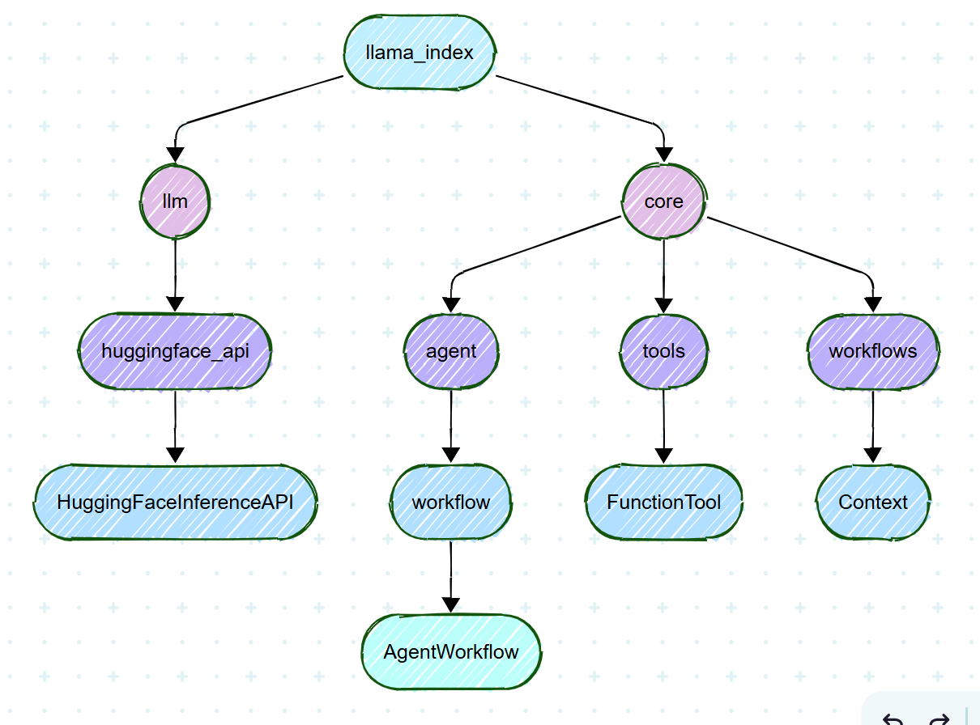
Build Agent Using LlamaIndex
llm = HuggingFaceInferenceAPI(model_name="Qwen/Qwen2.5-Coder-32B-Instruct")
agent = AgentWorkflow.from_tools_or_functions( [ FunctionTool.from_defaults(multiply)],
llm=llm )
36

Slide 37
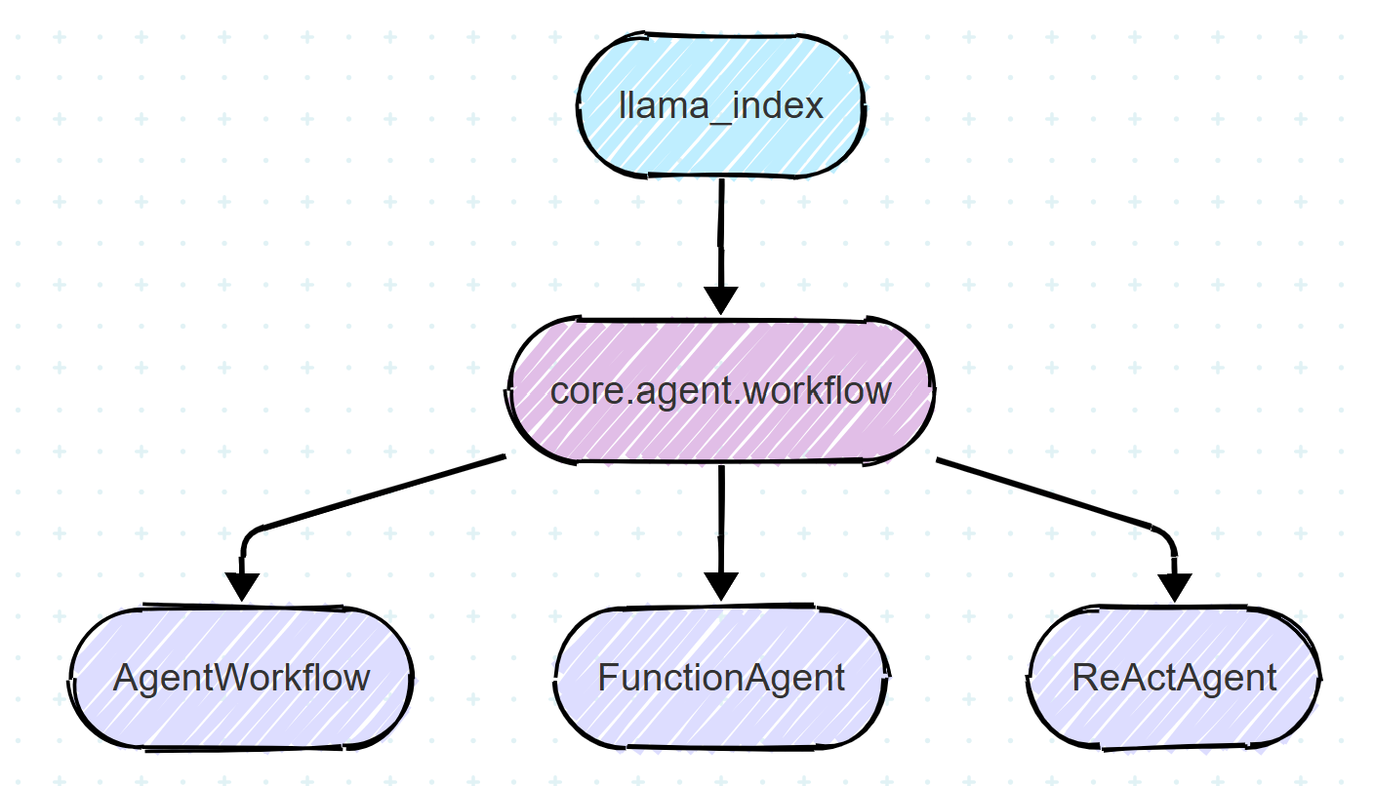
Build Multi Agent Using LlamaIndex
calculator_agent = ReActAgent( name="calculator",
description="Performs basic arithmetic operations",
system_prompt="You are a calculator assistant. Use your tools for any math operation.",
tools=[add, subtract], llm=llm, )
query_agent = ReActAgent( name="info_lookup",
description="Looks up information about XYZ",
system_prompt="Use your tool to query a RAG system to answer information about XYZ",
tools=[query_engine_tool], llm=llm )
agent = AgentWorkflow( agents=[calculator_agent, query_agent], root_agent="calculator" )
37

Slide 38
What are Workflow?
Workflows are multi-step processes that combine one or more agents, data connectors, and other tools to complete a task. They are event-driven software that allows you to combine RAG data sources and multiple agents to create a complex application that can perform a wide variety of tasks with reflection, error-correction, and other hallmarks of advanced LLM applications [5].
38

Slide 39
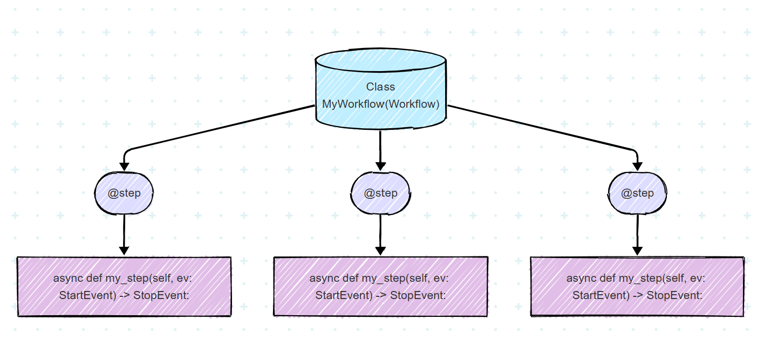
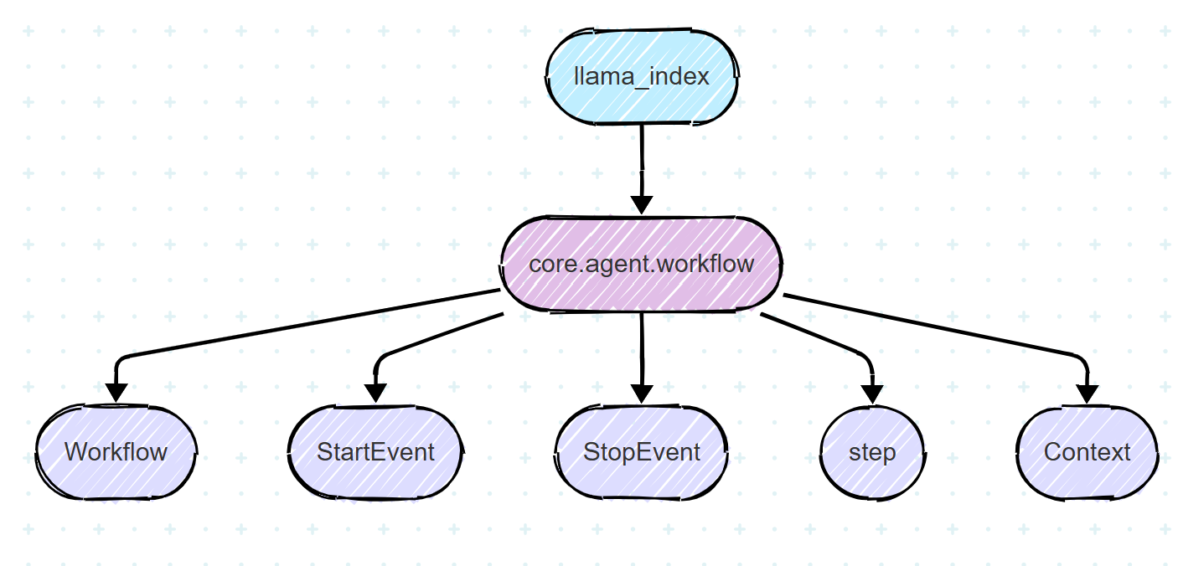
Build Workflow System
To Run: w = MyWorkflow(timeout=10, verbose=False)
result = await w.run()
39

Slide 40
LangGraph
40

Slide 41
What is LangGraph?
LangGraph is a framework developed by LangChain to manage the control flow of applications that integrate an LLM [7].
LangChain provides a standard interface to interact with models and other components, useful for retrieval, LLM calls and tools calls. The classes from LangChain might be used in LangGraph, but do not HAVE to be used [7].
41

Slide 42
Choose LangGraph for:
Reliability and Controllability
Low level and Extensile
First-Class Streaming Support
42

Slide 43
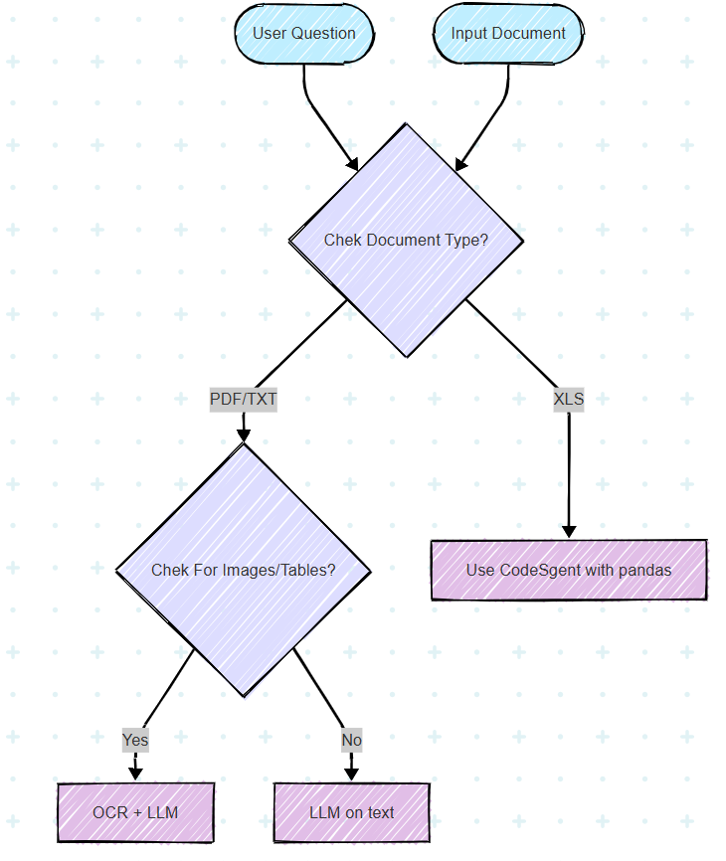
Simple Example of how work LangGraph
43

Slide 44
Components of LangGraph
1
State is the central concept in LangGraph. It represents all the information that flows through your application [7].
State
44

Slide 45
Components of LangGraph
2
Nodes are python functions. Each node:
Takes the state as input
Performs some operation
Returns updates to the state [7].
Nodes
45

Slide 46
Components of LangGraph
3
Edges connect nodes and define the possible paths through your graph
Edges can be:
Direct: Always go from node A to node B
Conditional: Choose the next node based on the current state [7].
Edges
46

Slide 47
Components of LangGraph
4
StateGraph
The StateGraph is the container that holds your entire agent workflow [7].
47

Slide 48
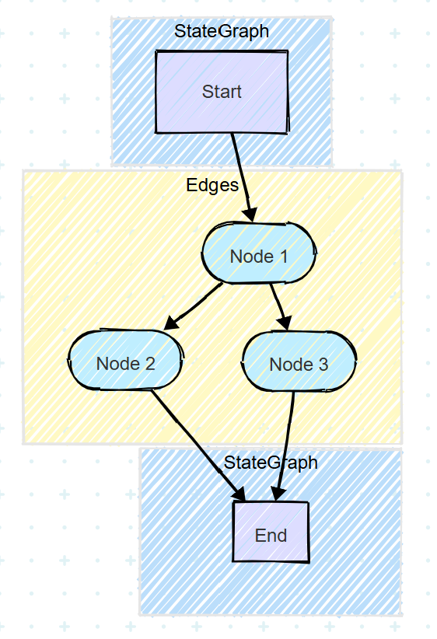
Components of LangGraph
48

Slide 49
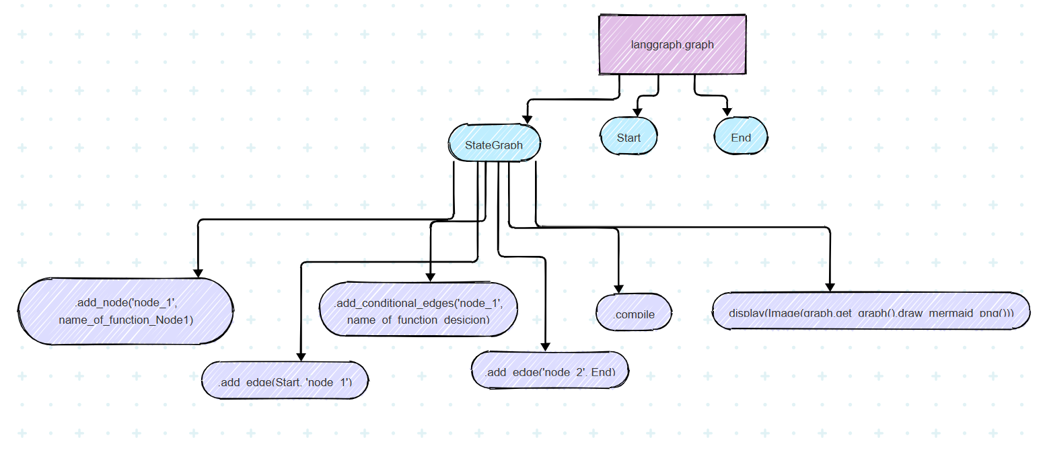
Components of LangGraph
49

Slide 50
Reference
https://www.coursera.org/articles/what-is-hugging-face [1]
https://huggingface.co/learn/agents-course/en/unit1/tutorial [2]
https://www.ibm.com/think/topics/llamaindex [3]
https://platform.openai.com/docs/guides/prompt-engineering [4]
https://docs.llamaindex.ai/en/stable/ [5]
https://huggingface.co/learn/agents-course/en/unit2/llama-index/introduction [6]
https://huggingface.co/learn/agents-course/en/unit2/langgraph/when_to_use_langgraph [7]
50

Slide 51

51

Slide 52
Thank You

